Slide 1
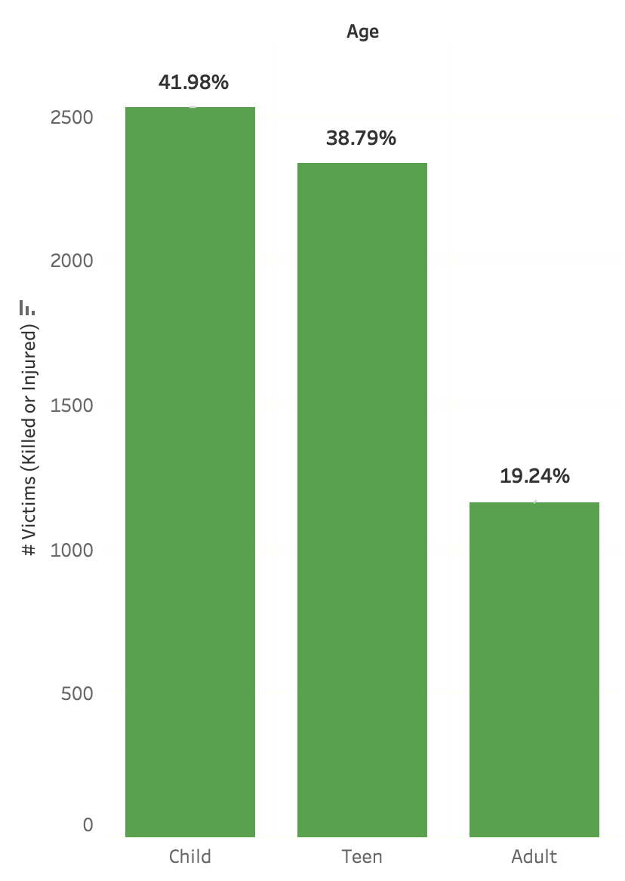

Every day,
children and teens
are killed or injured by guns.
Between 2014 - 2016,
15 were killed or injured
each day.
8 of every 10 casualties of
gun violence were children or teens.
Most...
Notes:
Every day, children and teens are killed or injured by guns.
Between 2014 and 2016 alone, there were
15 children and teens killed or injured each day
For every 10 casualties of gun violence, 8 were children or teens.
But most incidents…

Slide 2
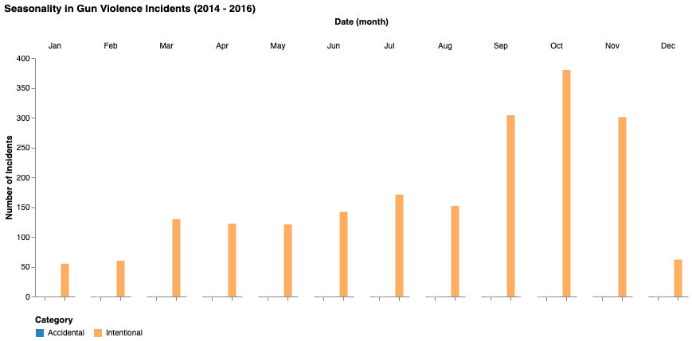
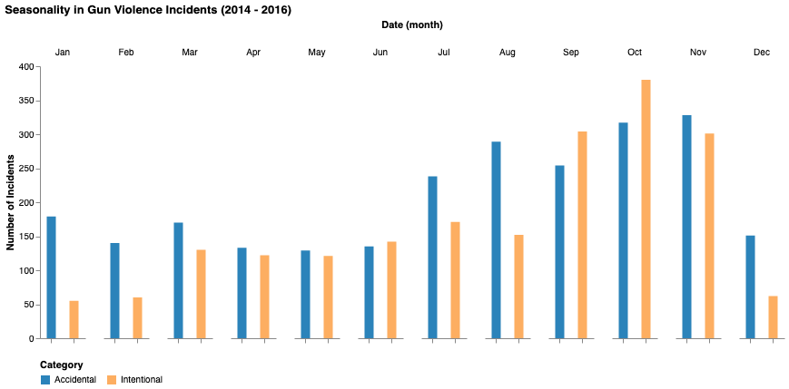
occur
later in the year (during hunting season).
And could have been prevented.
Notes:
Occur later in the year, when hunting season is on. This may be due children and teens having more access to guns.
Sadly, many of these accidents involving guns could have been prevented with the right precaution measures.

Slide 3
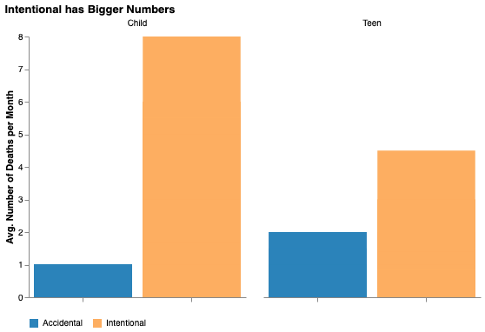

.
Did you know?
But
.
.
On average,
8 child
Are
killed intentionally
each month
throughout the year.
4 teens
This is a year long problem.
It is not
seasonal.
Notes:
But… Did you know?
On average, 8 children and 4 teens are killed intentionally each month throughout the year
Making this a year long problem to be solved.
Gun violence amongst children and teens is not seasonal.

Slide 4

How do we protect our children and teens?
As gun owners on keeping their homes safe when children and teens are present:
- keep them locked and unloaded
- educate your children on gun safety
- be SMART
Secure all guns in homes and vehicles.
Model responsible behavior.
Ask about unsecured guns in other homes.
Recognize the role of guns in suicide.
Tell your peers to Be SMART.
Notes:
How do we keep our children and teens safe?
As gun owners, we need to be vigilant and protect them by
- keeping guns locked and unloaded.
- Educate children from young on the dangers of gun and how to handle them safely. Create an environment where they can talk about it comfortably.
- Be sure to be smart by
Securing all guns in home and vehicles
Model responsible behaviour
Ask about unsecured guns in other homes
Recognize the role of guns in suicide
And don’t forget to Tell your peers to be smart as well.

Slide 5

Measures like background checks and legislation can only go so far.
YOU
can make a difference.
Be
SMART.
Help keep our children safe
from guns.

Slide 6
This public service message is brought to you by Saira Gurung, Rachel Lee, Kyle Wright Music: A New Way by David Fesliyan
Notes:
https://www.fesliyanstudios.com/download-link.php?src=i&id=111

